Slide 1


EnronOnline
Technology
Report Date- June 2, 2000
Confidential

Slide 2
EnronOnline
Project Objective:
The scope of our review was designed to understand and identify key control mechanisms within the global EnronOnline (EOL) environment. Our audit procedures included interviews with IT Compliance group personnel, as well as review and assessment of available policy and procedure documentation to identify strengths and weaknesses related to the existing control environment.
AA Team Members:
Tom Bauer
Ed Hill
Michael Schultz
Jim Brown
Jennifer Stevenson
Cindy Davis
Russ Bouwhuis
Enron Team Members:
Louise Kitchen
Andrew Parsons
Mark Thibodeaux
Steven Simpson

Slide 3
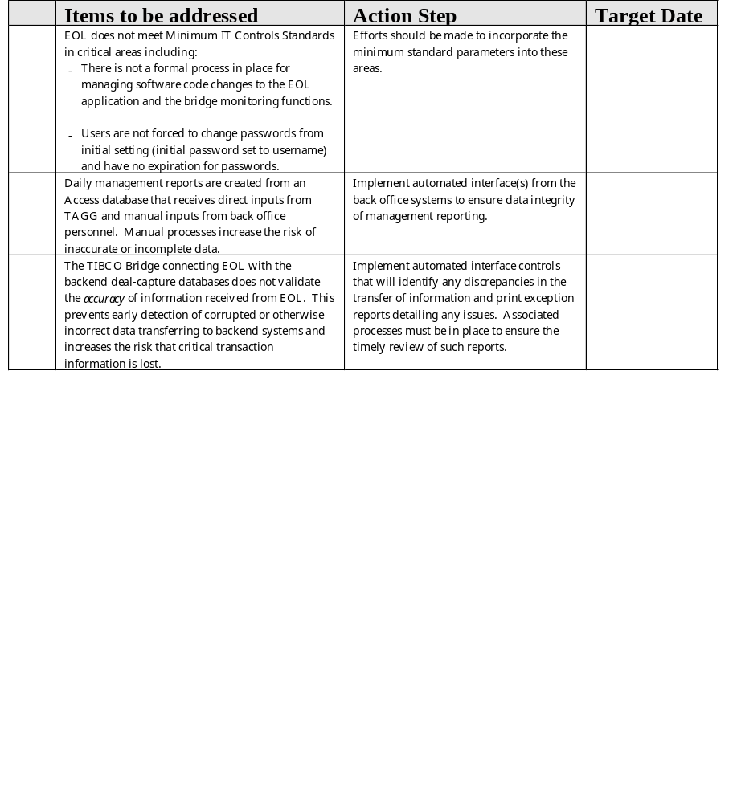
EnronOnline Observations
A
B
C

Slide 4
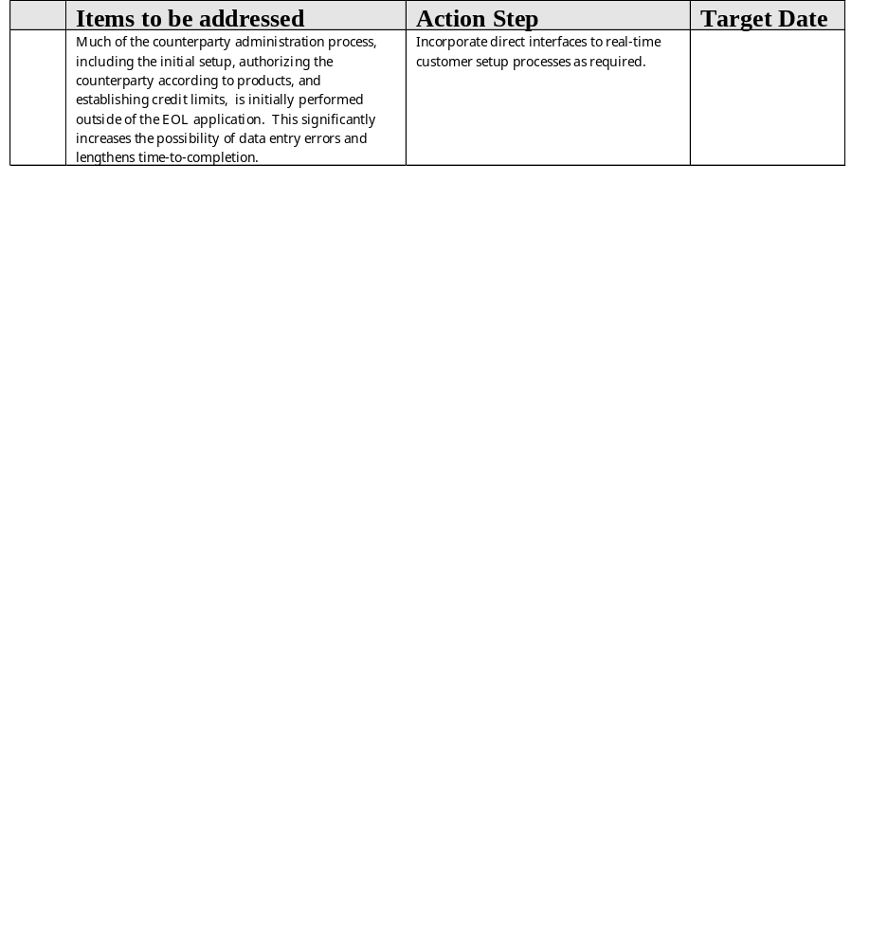
EnronOnline Observations
D

Slide 5
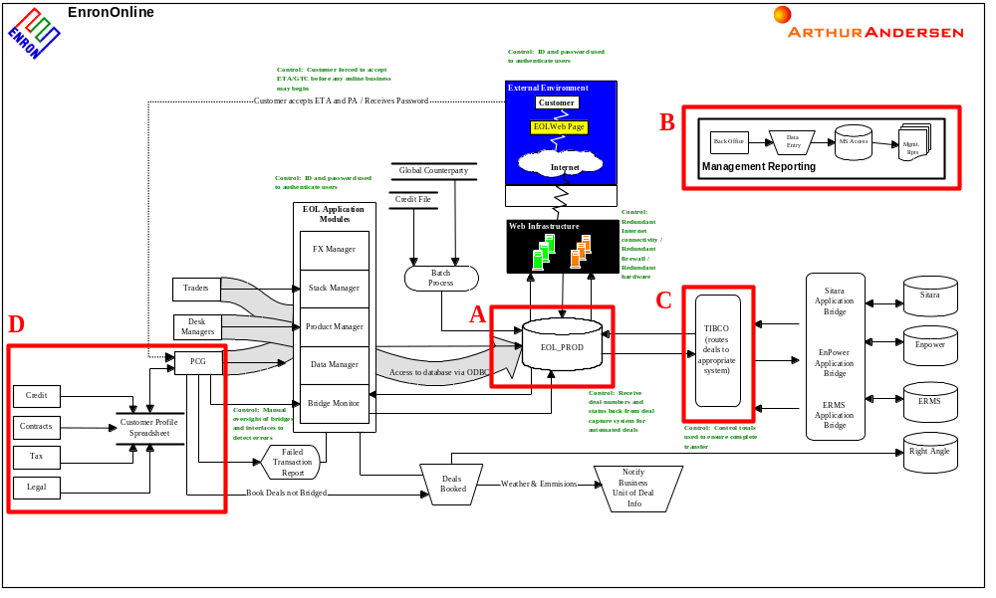
EnronOnline

